Slide 1

Machine Learning

Slide 2
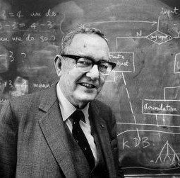
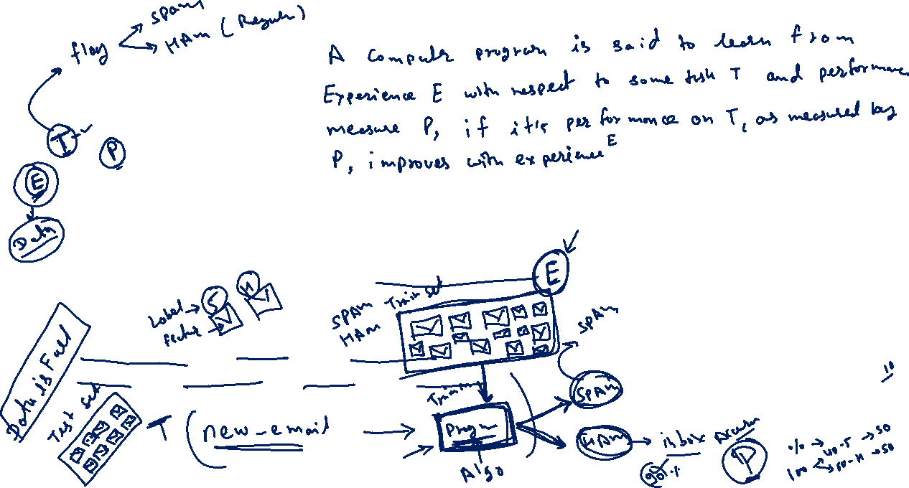
Machine Learning
“here are problems to which we simply don’t know the answer yet, but there are some things we can take actions on now, which we should take actions on now.”
“Learning is any process by whcih a system improves performance from experience”
“machine learning is concerned with computer programs that automatically improve their performance though experience”
Herbert Simon (Father of AI)
Turing Award 1975
Nobal Prize in Economics 1978

Slide 3

Quotes on machine Learning
“… What we want is a machine that can learn from experience.”
Alan Turing 1947
“A breakthrough in Machine Learning would be worth10 Microsoft.”
Bill Gates
“With artificial Intelligence we are summoning the demon.”
Elon Mask
“Machine learning is the next Internet”
Tony Tether, Director, DARPA

Slide 4
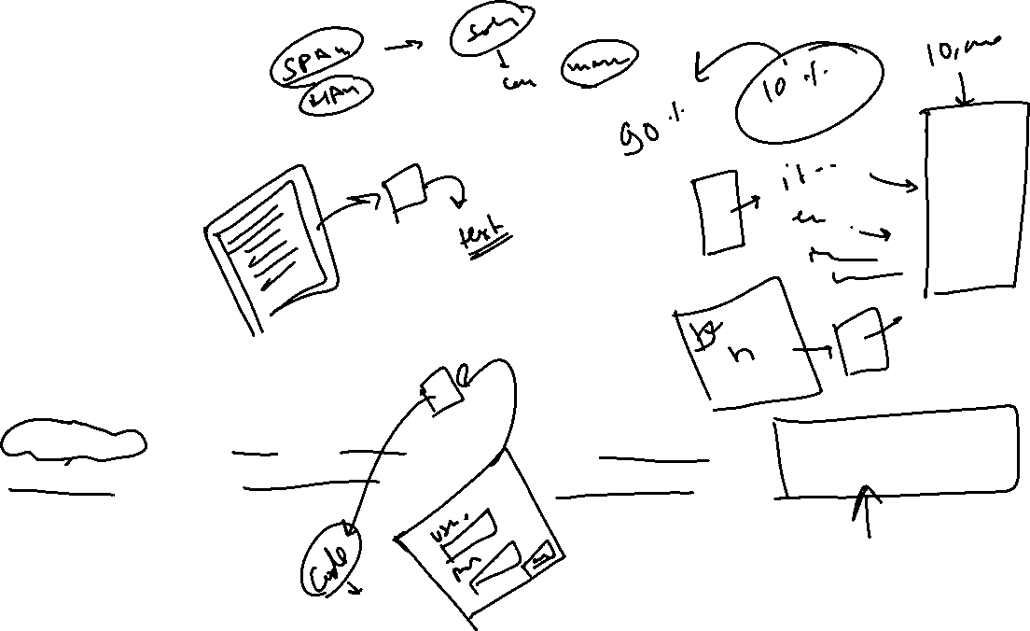
So What Is Machine Learning?
Automating automation
Getting computers to program themselves
Writing software is the bottleneck
Let the data do the work instead!

Slide 5
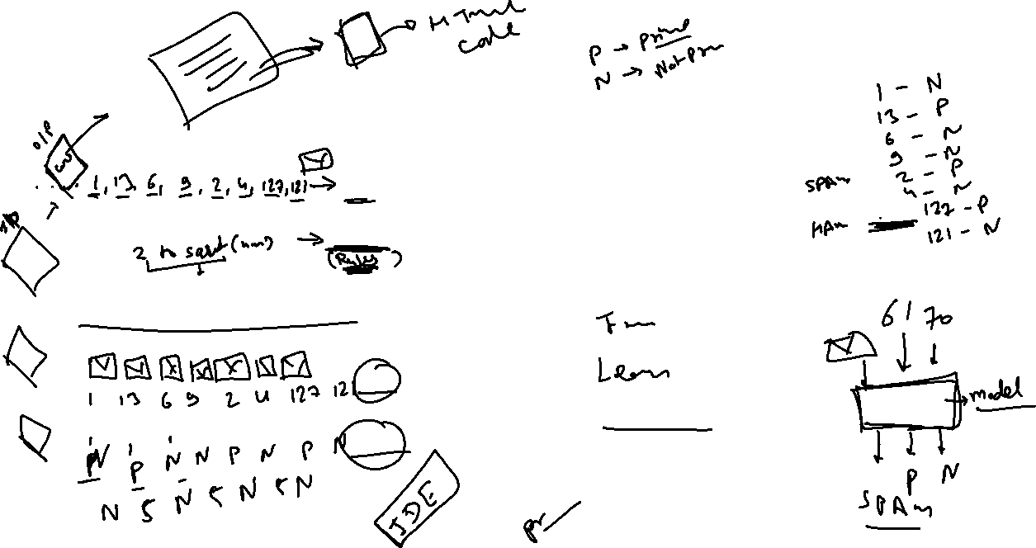
Traditional Programming
Machine Learning
Computer
Data
Output
Program
Computer
Data
Program
Output

Slide 6

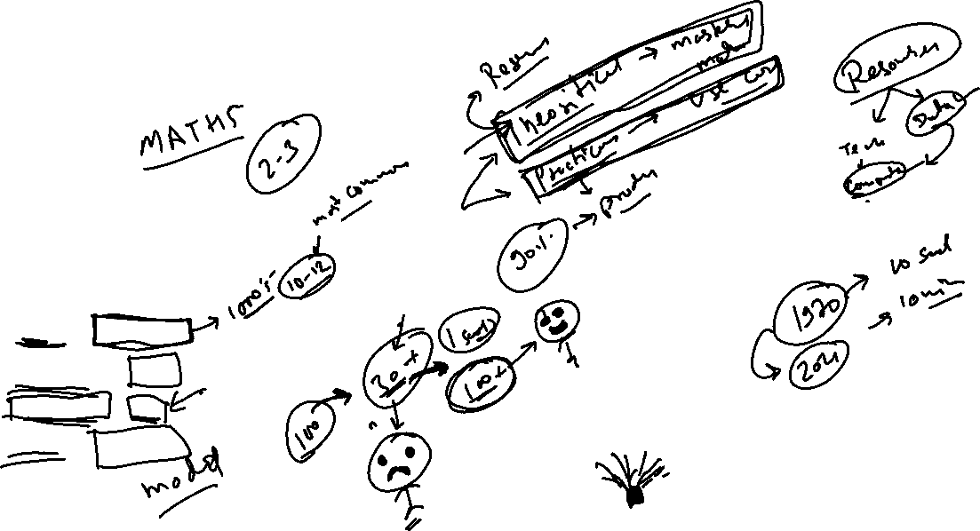
Magic?
No, more like gardening
Seeds = Algorithms
Nutrients = Data
Gardener = You
Plants = Programs

Slide 7

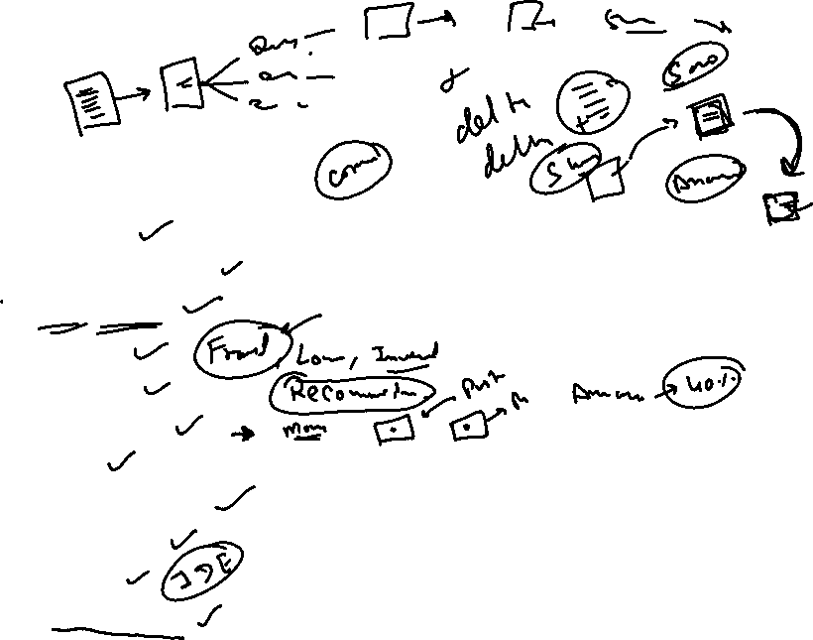
Sample Applications
Web search
Computational biology
Object Detection
Finance
E-commerce
Space exploration
Robotics
Information extraction
Social networks
Debugging
[Your favorite area]

Slide 8

Real World Applications of Machine Learning

Slide 9
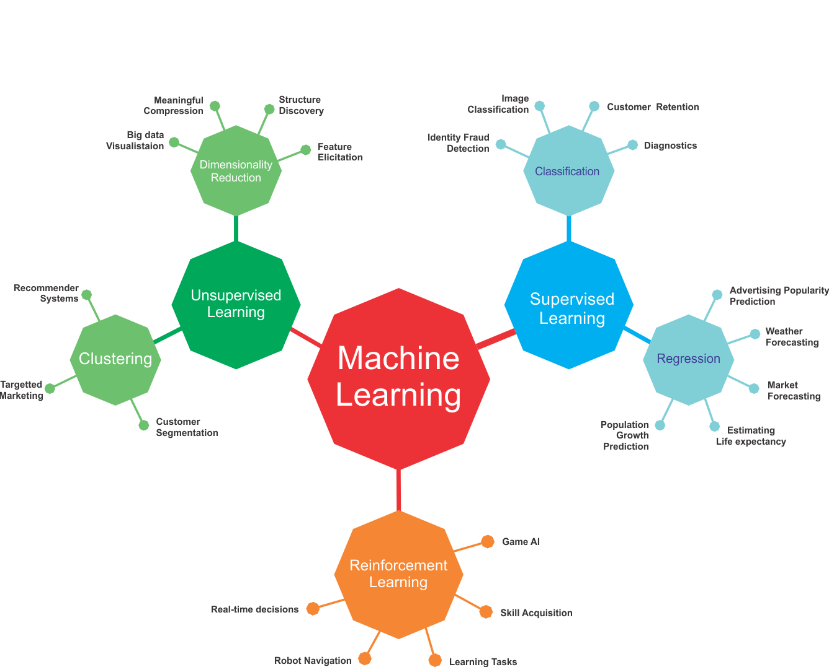
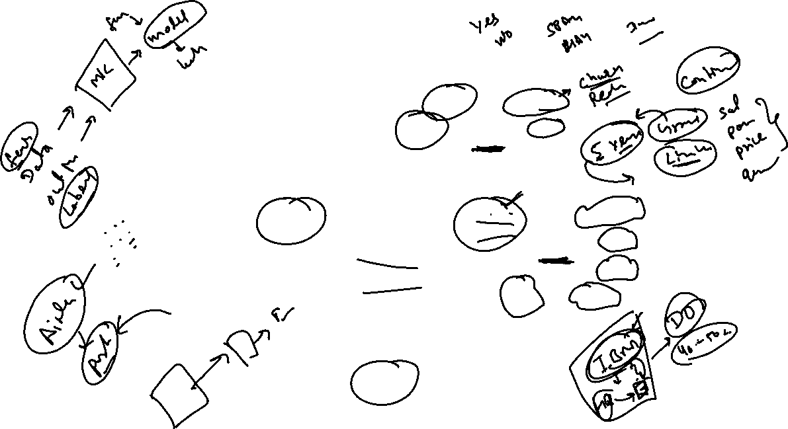

Slide 10
ML in a Nutshell
Tens of thousands of machine learning algorithms
Hundreds new every year
Every machine learning algorithm has three components:
Representation
Evaluation
Optimization

Slide 11
Representation
Decision trees
Sets of rules / Logic programs
Instances
Graphical models (Bayes/Markov nets)
Neural networks
Support vector machines
Model ensembles
Etc.

Slide 12
Evaluation
Accuracy
Precision and recall
Squared error
Likelihood
Posterior probability
Cost / Utility
Margin
Entropy
K-L divergence
Etc.

Slide 13
Optimization
Combinatorial optimization
E.g.: Greedy search
Convex optimization
E.g.: Gradient descent
Constrained optimization
E.g.: Linear programming

Slide 14
Types of Learning
Supervised (inductive) learning
Training data includes desired outputs
Unsupervised learning
Training data does not include desired outputs
Semi-supervised learning
Training data includes a few desired outputs
Reinforcement learning
Rewards from sequence of actions

Slide 15

Inductive Learning
Given examples of a function (X, F(X))
Predict function F(X) for new examples X
Discrete F(X): Classification
Continuous F(X): Regression
F(X) = Probability(X): Probability estimation

Slide 17
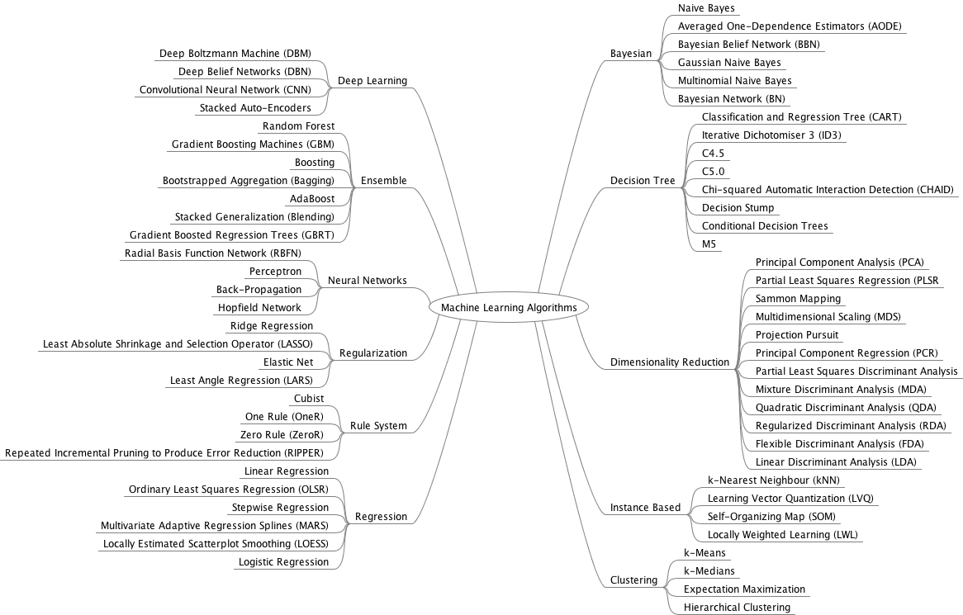

Slide 18

What We’ll Cover
Supervised learning
Decision tree induction
Rule induction
Instance-based learning
Bayesian learning
Neural networks
Support vector machines
Model ensembles
Learning theory
Unsupervised learning
Clustering
Dimensionality reduction

Slide 19
ML in Practice
Understanding domain, prior knowledge, and goals
Data integration, selection, cleaning, pre-processing, etc.
Learning models
Interpreting results
Deploying Models in Real

Slide 20
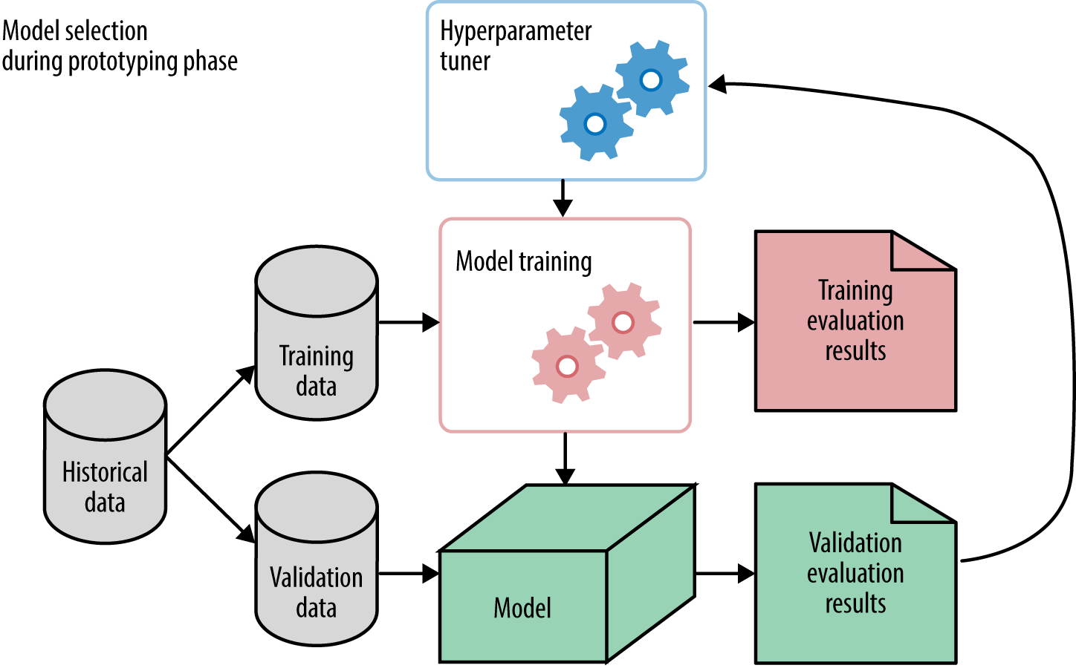
Steps to build a machine learning model

Slide 21
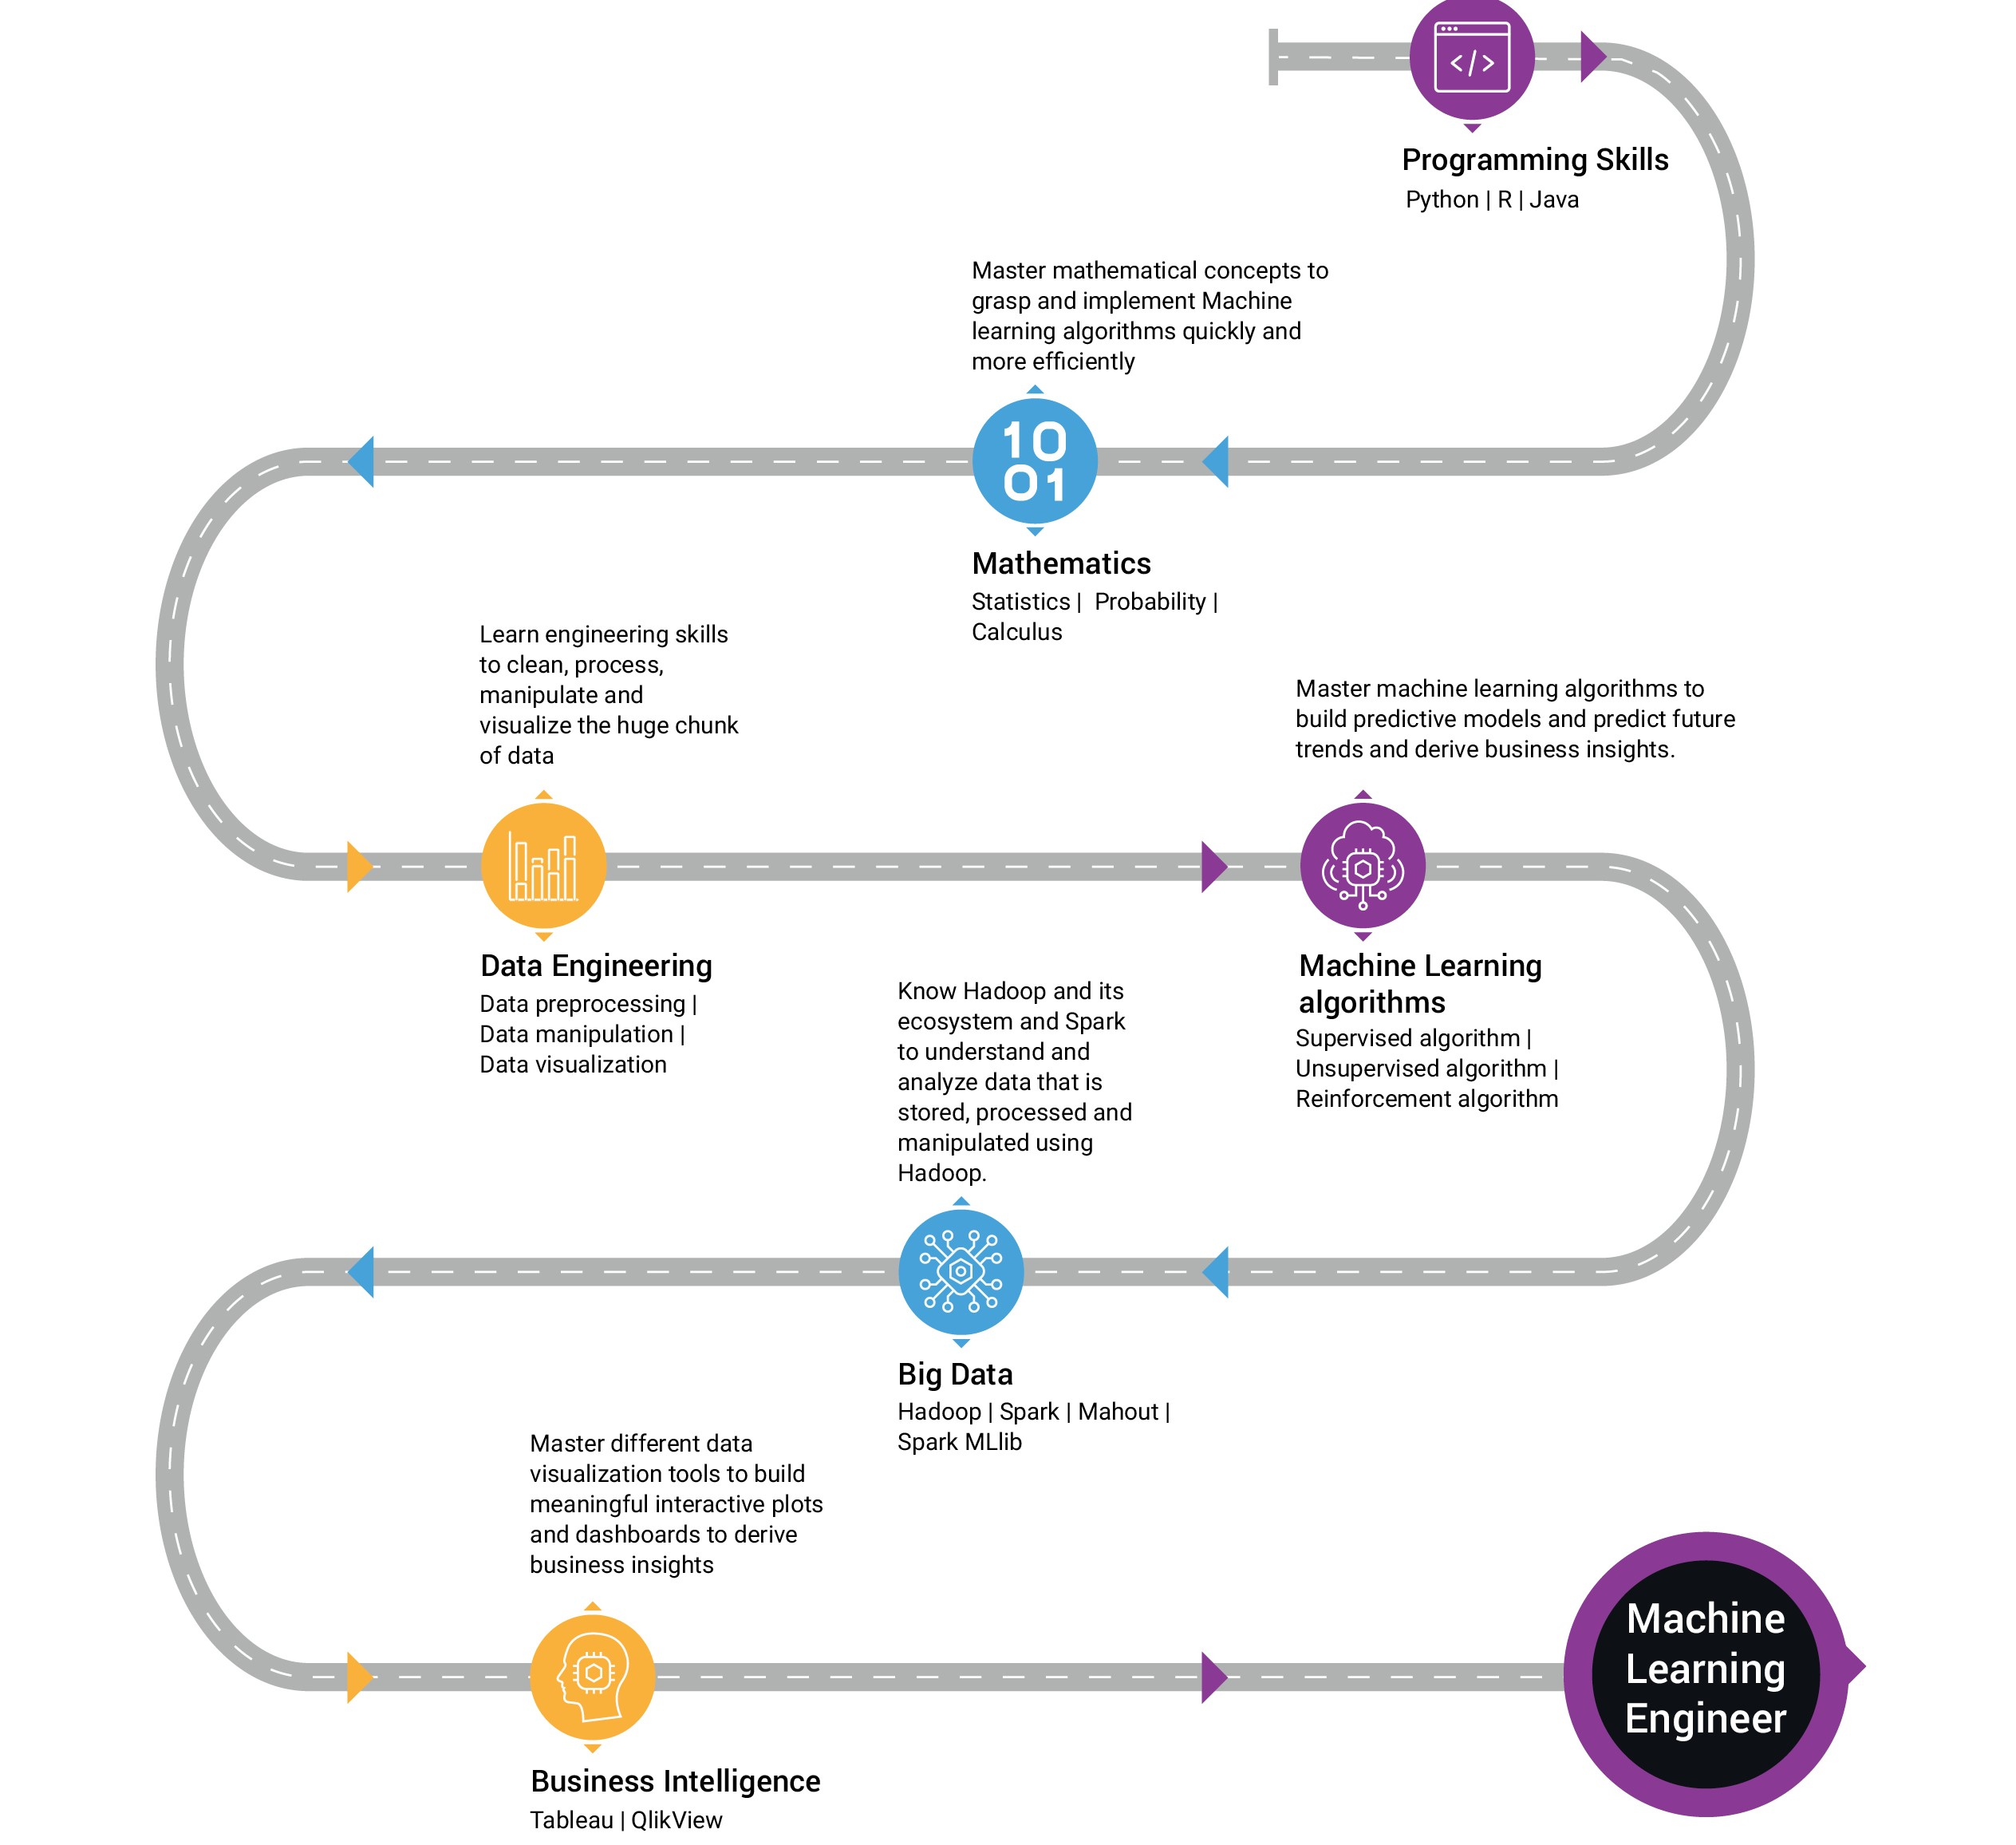
SKILLS REQUIRED

Slide 22
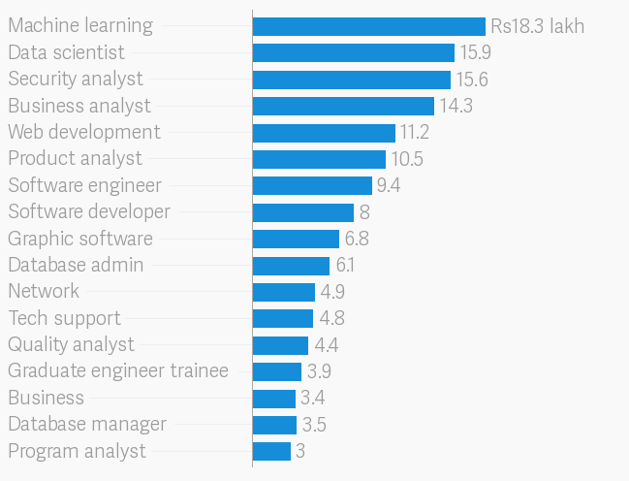
Machine Learning Job Scope & Salary Trends

Slide 23
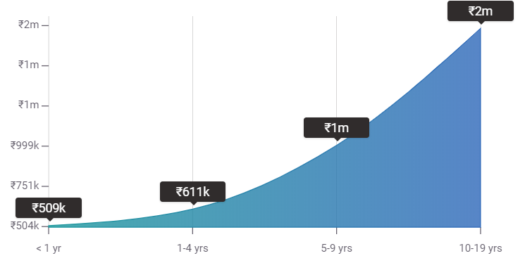
Increment WRT Experience

Slide 24

Queries Please ?

Slide 25

THANKS

